Slide 1
The 5 C’s of Credible Academic Writing

Slide 2
Credible and Effective Writing is
Clear
Coherent
Concise
Concrete
Correct

Slide 3

“CLEAR writing conveys the purpose of the document immediately to the reader”
How do we build clarity into our writing?
Notes:
http://educredservices.com/blog/2015/1/6/a-time-to-re-focus-new-year-new-vision-renewed-commitment

Slide 4
Build clarity by
Plan: know what you want to say
Know your audience: understand their needs
Match vocabulary to audience: write to EXPRESS, not impress
Choose effective sentence structures
Construct unified paragraphs

Slide 5
Clear Paragraph Construction: TEEC
T: Topic Sentence controls the entire paragraph
E: Examples and Evidence to support your topic
E: Explain how your evidence supports ideas
C: Conclude logically

Slide 6

COHERENT writing ensures that the reader can easily follow your ideas and your train of thought. One idea leads logically to the next without leaving gaps that confuse the reader.
How do we build coherence into our writing?
Notes:
http://www.ourclipart.com/clipart/cohesion%20clipart/#gal_cohesion-clipart_2685453.jpg

Slide 7
Build Coherence by
Using logical transitions to link sentences
Organizing document information logically
Strategic repetition
Using parallel construction
Resource: Transitional Words and Phrases for University Writing

Slide 8

CONCISE writing uses the least words possible to convey the most meaning while still maintaining clarity.
How can we improve conciseness in our writing?

Slide 9
Be Concise by
Avoiding meaningless padding and unnecessary repetition
Avoid vague generalities, tired clichés, and awkward phrasing (eg: passive verb constructions)
Avoid stating the perfectly obvious
Think of your word count like a budget: cut a word, save a buck!
Resource: “Communicating with Precision”

Slide 10
Revise the following to be more concise:
Energy drinks may be consumed in many different ways. Drinking energy drinks can provide the helpful benefits of increased awareness and energy. However, even with the enhancements that may arise from drinking an energy drink, there may be ill effects which pose more of a threat to a person than the energy boost that a person may receive.
Notes:
Try reading this out loud, and then try to determine what the main point of this paragraph is. How can this be revised to express that idea more clearly, coherently and concisely?

Slide 11
Rethink the topic sentence:
Energy drinks may be consumed in many different ways. Drinking energy drinks can provide the helpful benefits of increased awareness and energy. However, even with the enhancements that may arise from drinking an energy drink, there may be ill effects which pose more of a threat to a person than the energy boost that a person may receive.
Cut meaningless padding!
Notes:
First, notice that the first sentence does not offer a meaningful topic sentence. It is simply meaningless padding.

Slide 12
Cut repetition
Drinking energy drinks can provide the helpful benefits of increased awareness and energy. However, even with the enhancements that may arise from drinking an energy drink, but there may be ill effects which pose more of a threat to a person than the energy boost that a person may receive.
Get to the point! Don’t waste your reader’s time.
Notes:
Get rid of redundant phrasing and repetition. The definition of “benefit” is something that is helpful; thus, you don’t need to use the modifier “helpful” when discussing benefits. The 2nd sentence needlessly repeats the idea presented in the first sentence, but in a more awkward way.

Slide 13
Revised versions:
Simple Sentence: | The negative effects of energy drinks outweigh the benefits.
Compound Sentence | Energy drinks can increase awareness and energy; however, they can also cause harmful side effects.
Complex Sentence | Although energy drinks can increase awareness and energy, they can have negative effects that outweigh these benefits
Notes:
As you can see, the entire paragraph was really just a first attempt at getting to a clear Topic Sentence. Depending on how you phrase this topic sentence, you will create reader expectation for the paragraph that follows.

Slide 14

CONCRETE writing involves using specific, precise language to paint a picture for your readers so that they can more easily understand your ideas.
How can we improve the precision of our writing?

Slide 15
Be Concrete by
Avoiding abstract words – or if you must use them, define them using concrete examples
Find the most precise word to express your idea
Use measurable terms whenever possible
Choose words that create pictures in the reader’s mind
Resource: Communicating with Precision

Slide 16

CORRECT writing, in terms of both grammar and factual accuracy, can determine your effectiveness and credibility.
How can we improve the correctness of our writing?

Slide 17
Be Correct by
Checking your facts and verifying information before passing it along
Using reliable sources for information
Reviewing grammar rules as necessary
Having a peer review what you have written
Resource: O.W.L. Mechanics Review

Slide 18
Other C’s to keep in mind
CREATIVE
CREDIBLE
CONSTRUCTIVE
COURTEOUS
COMPLETE

Slide 19
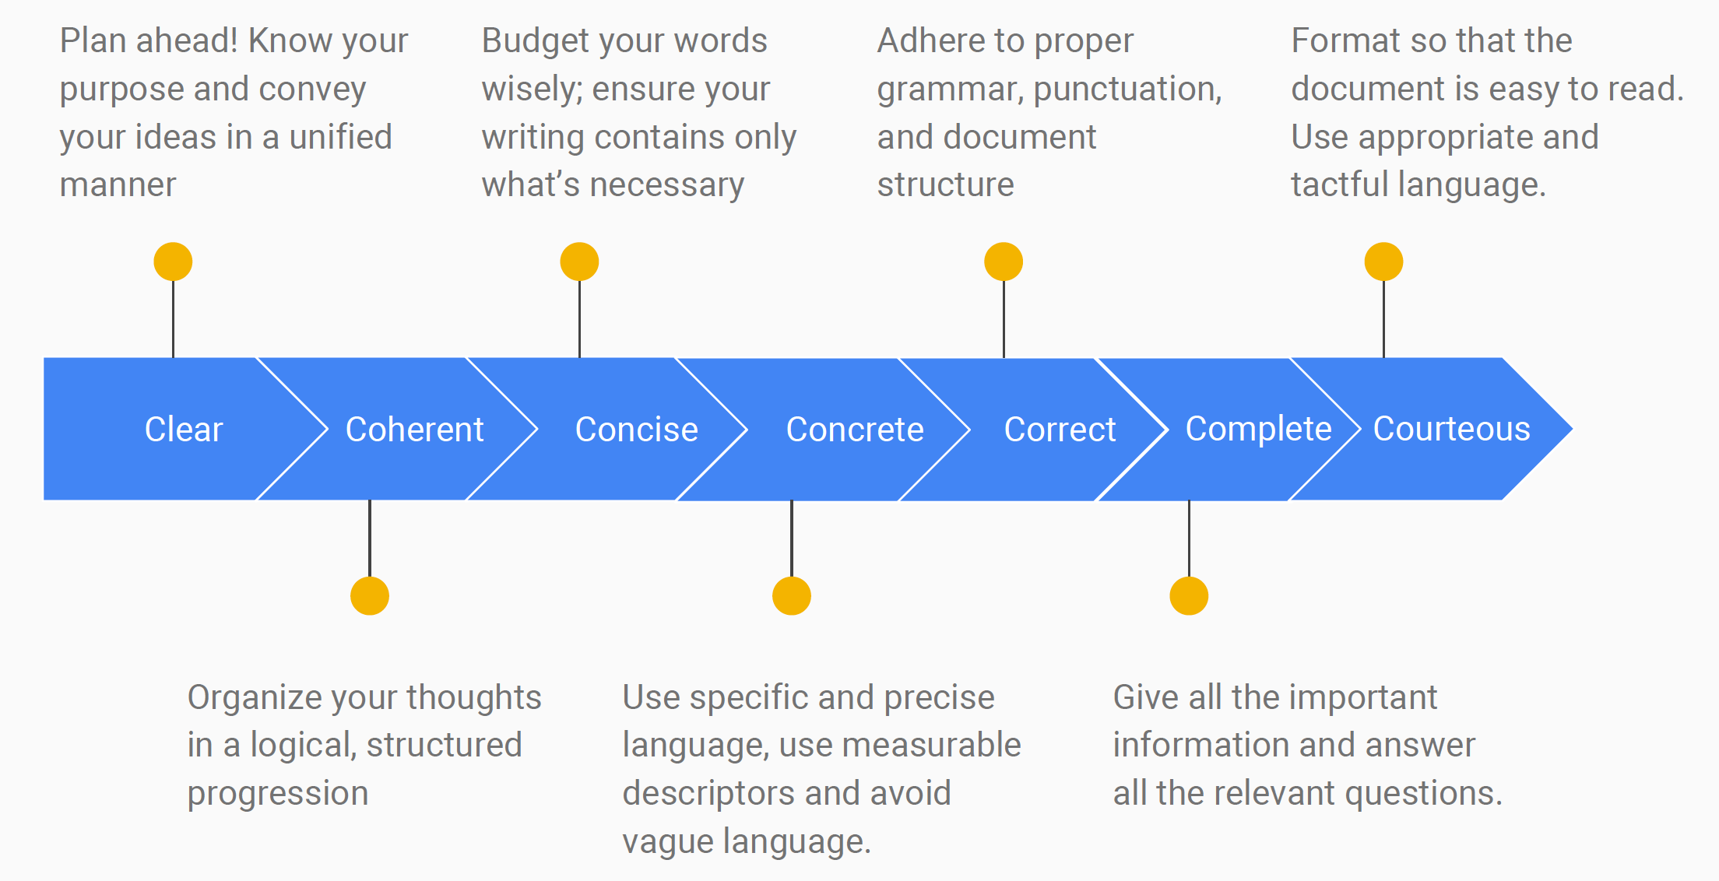
Written work is evaluated on how well it adheres to the 5 Cs

Slide 20
The 5 C’s of Credible Academic Writing
Credible
Clear
Coherent
Concise
Concrete
Correct

